Slide 1
IL RUOLO DEL PALLONCINO INTRAGASTRICO NEL 2026
Loredana Gualtieri
Digestive endoscopy Unit
Fondazione policlinico universitario irccs agostino gemelli

Slide 2
Still Relevant or Just a Bridge?

Slide 3
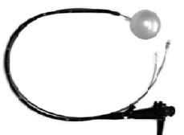
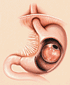
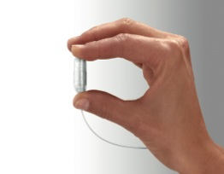
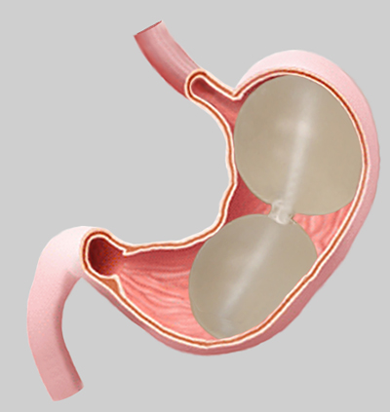


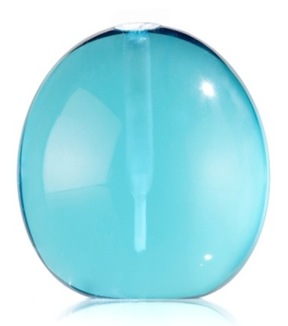
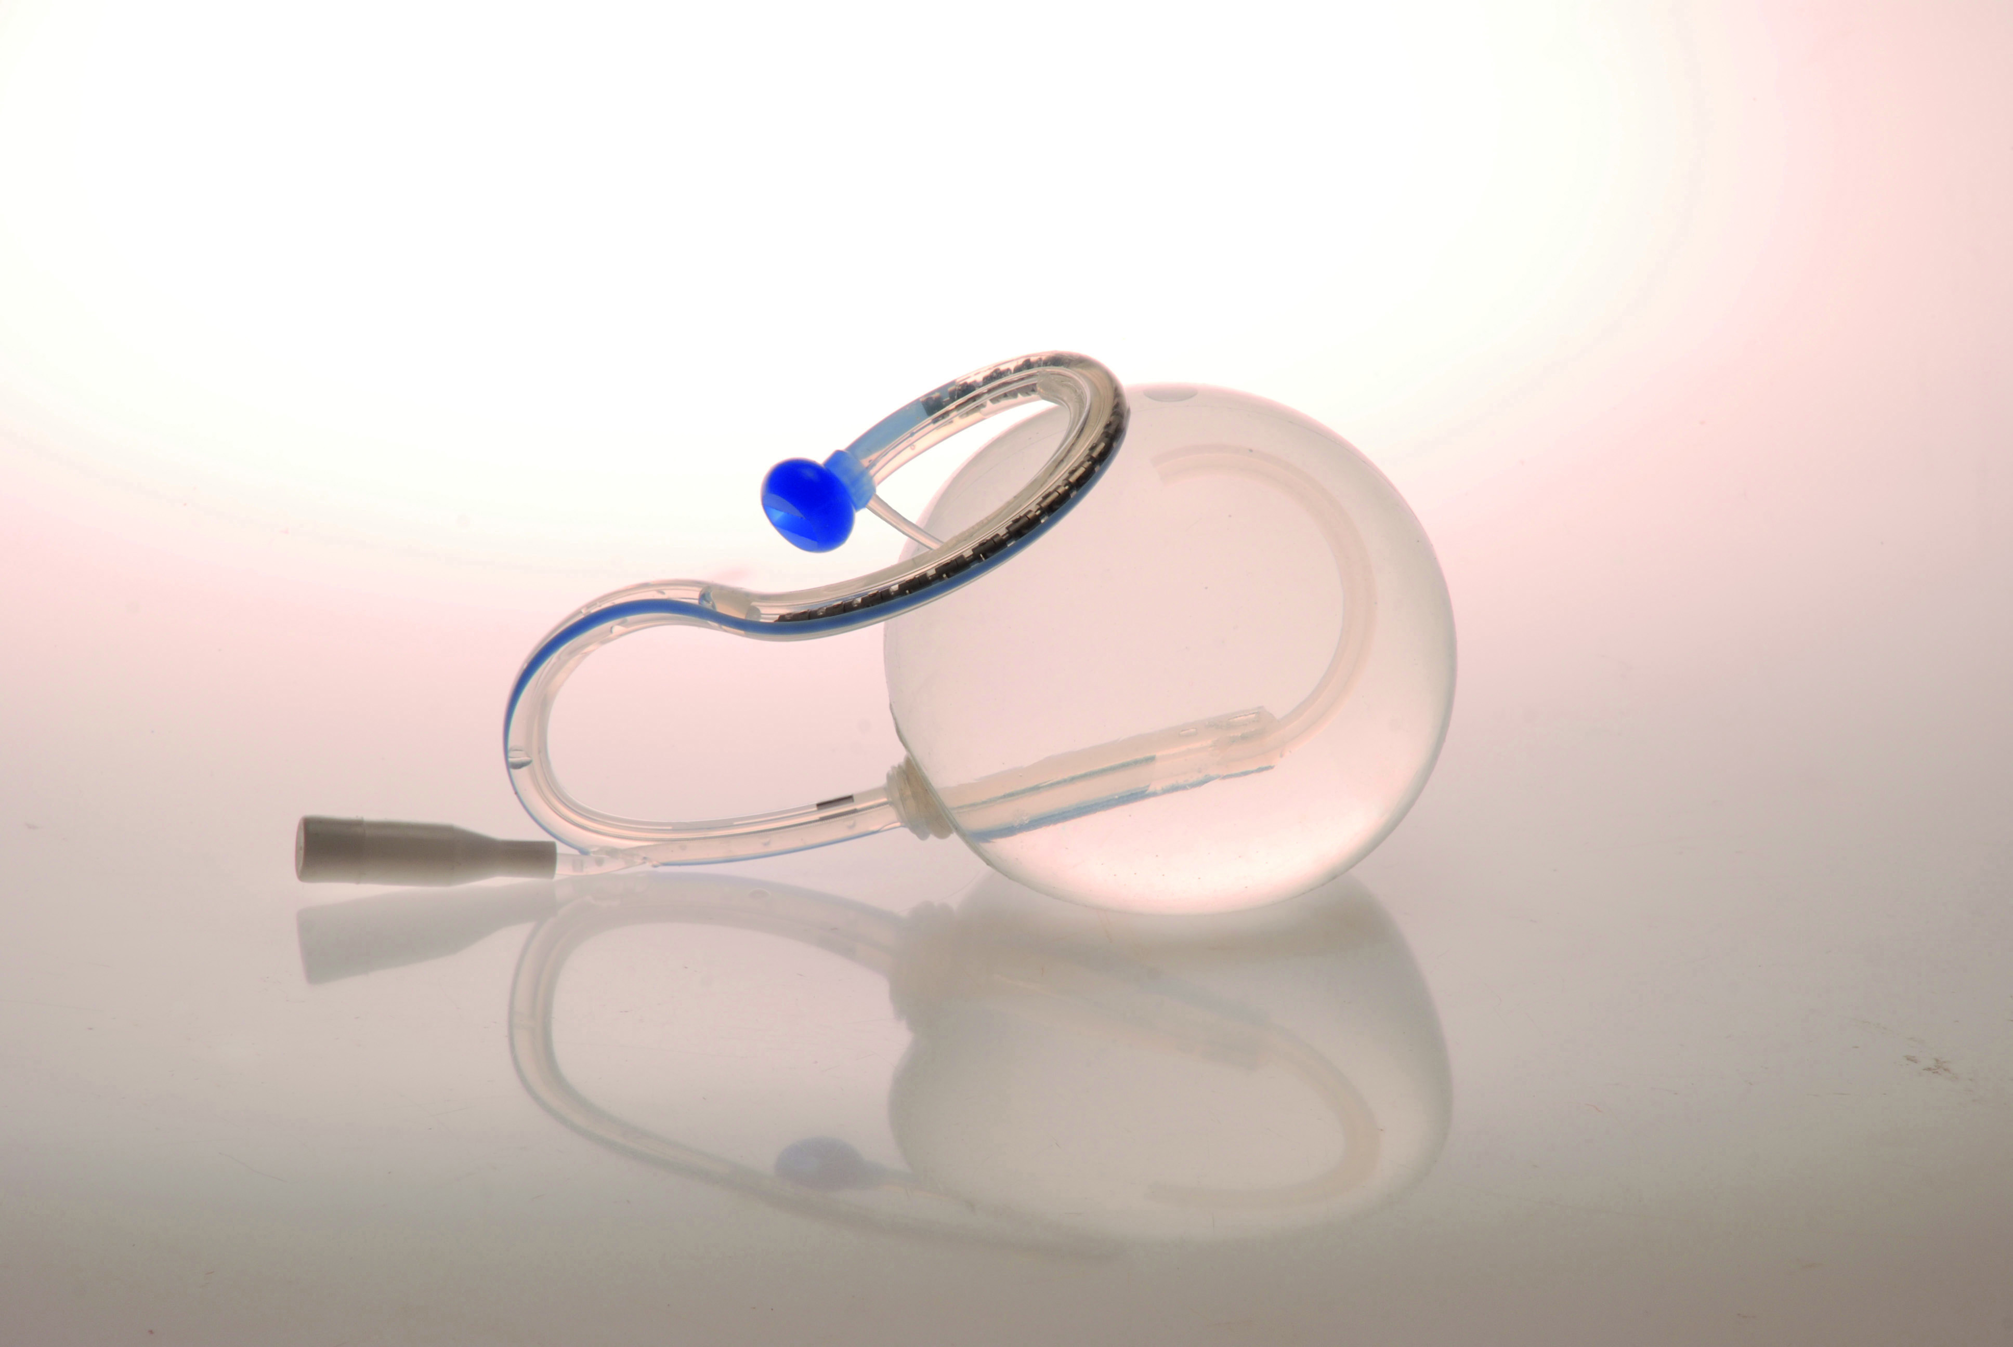
INTRAGASTRIC BALLOONS
Endalis
What is an IGB?
- Endoscopic device
- 400–700 mL
- Temporary (~6-12 months)
Mechanism
- Mechanical restriction
- Delayed emptying
- Early satiety
Hormonal effect
- ↑ GLP-1, ↑ PYY, ↓ Ghrelin
Orbera
Obalon
ENDOSCOPICALLY
ASSISTED
Reshape
Silimed
SWALLABLE
Elipse
Medsil
Spatz
Boškoski, I. et al. – Endoscopy 2025
Li, S.H. et al. - Chin. Med. J. 2018
Ghusn, W. et al. - Medicina 2025
Mehta, A. et al - Clin. Med. Insights Gastroenterol. 2021

Slide 4
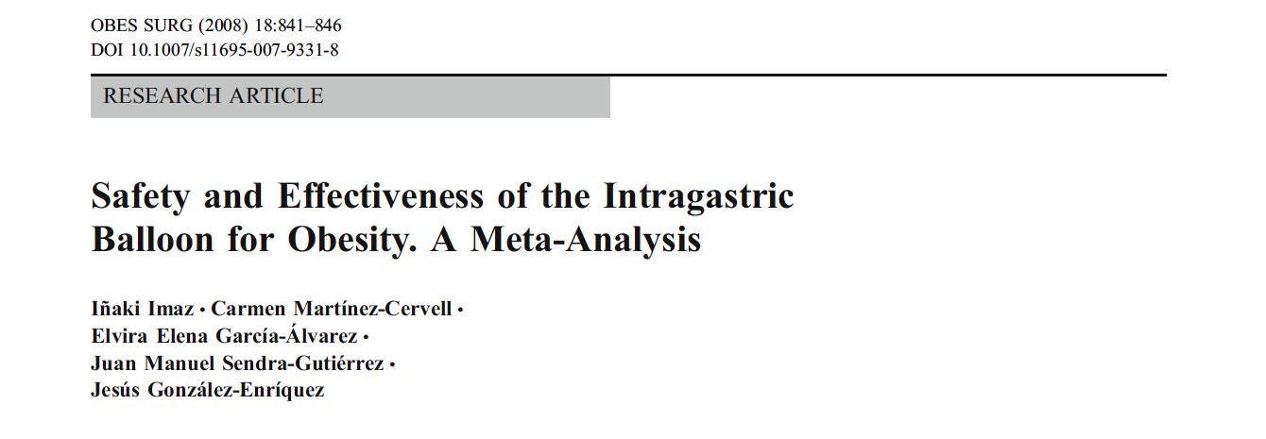
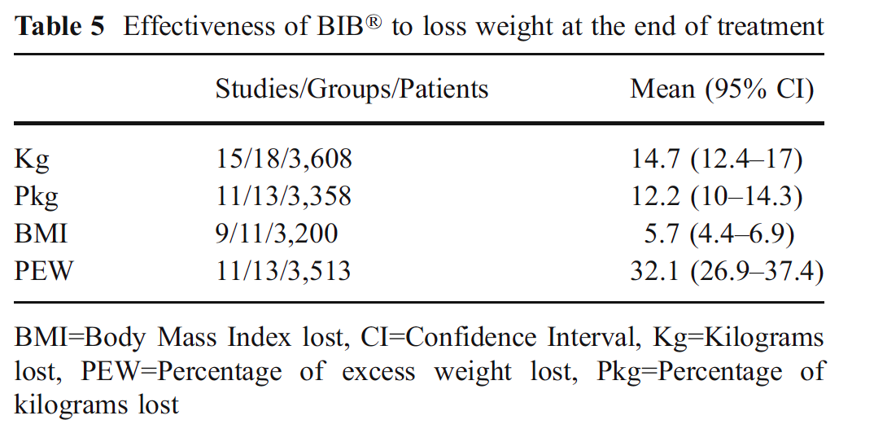
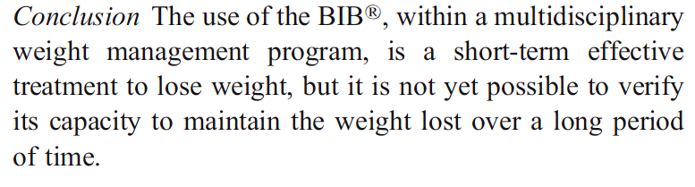

Slide 5
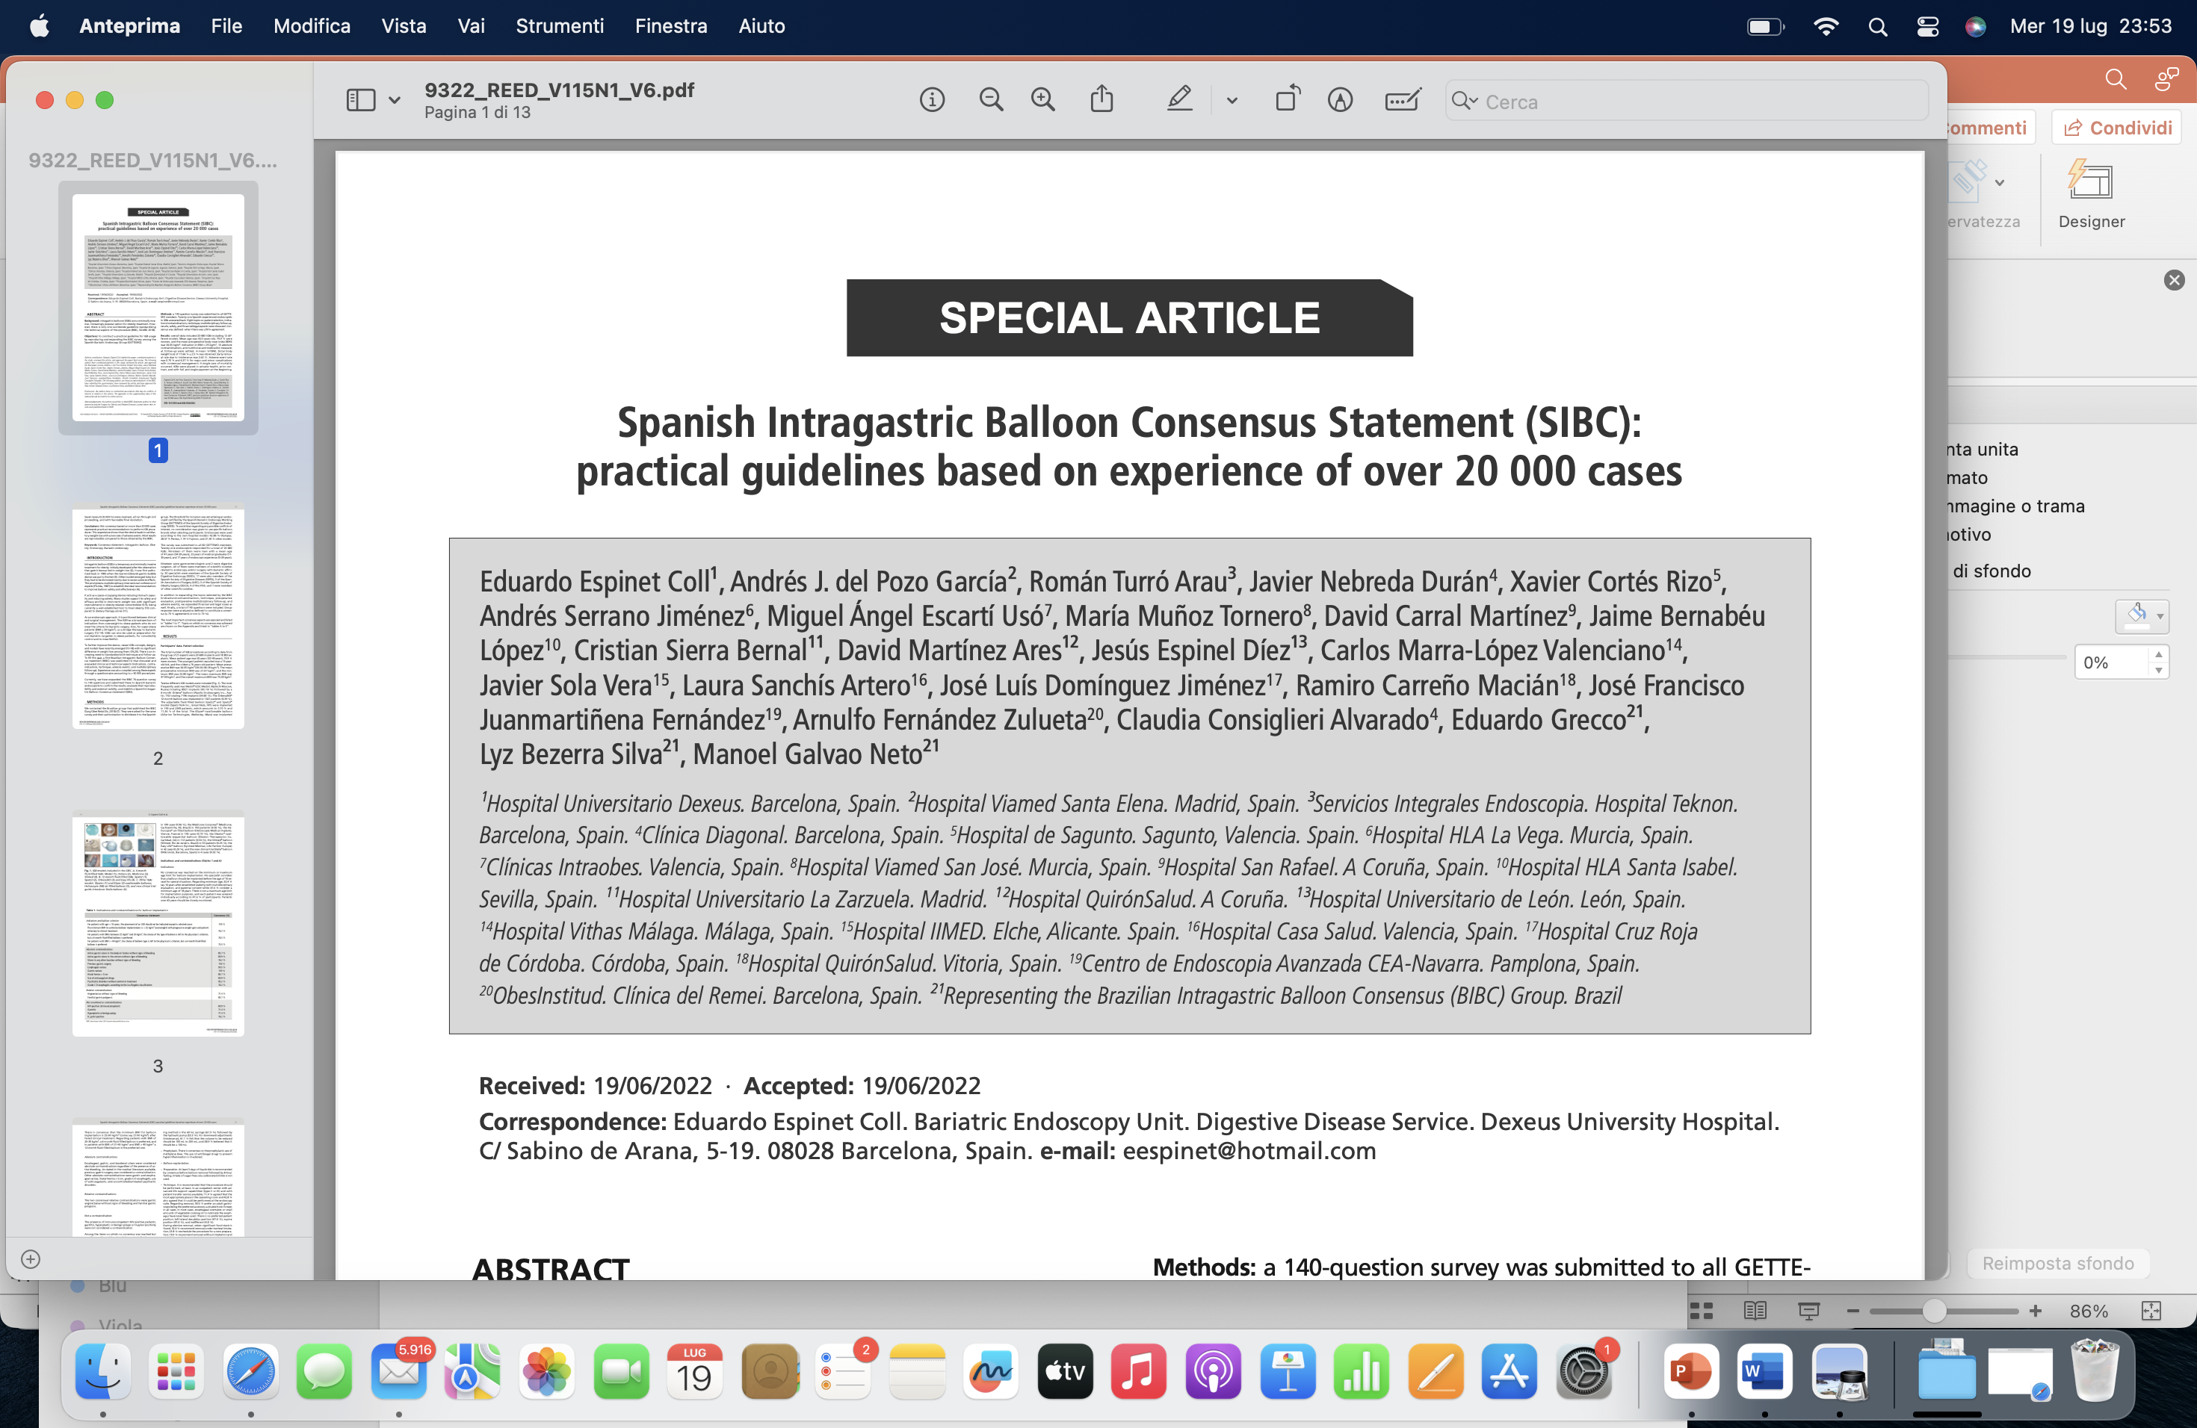

Slide 6
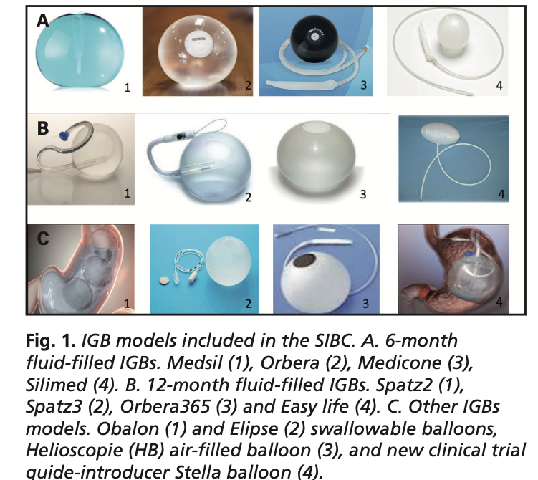
20.680 cases
Twelve different IGB
models included

Slide 7
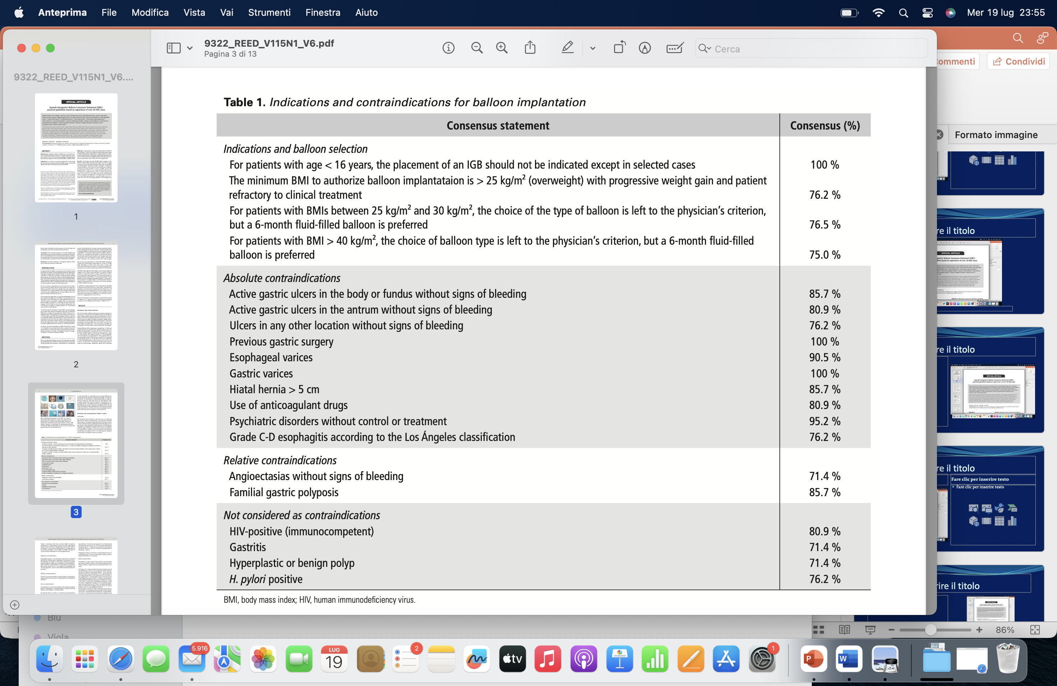
Indications

Slide 8

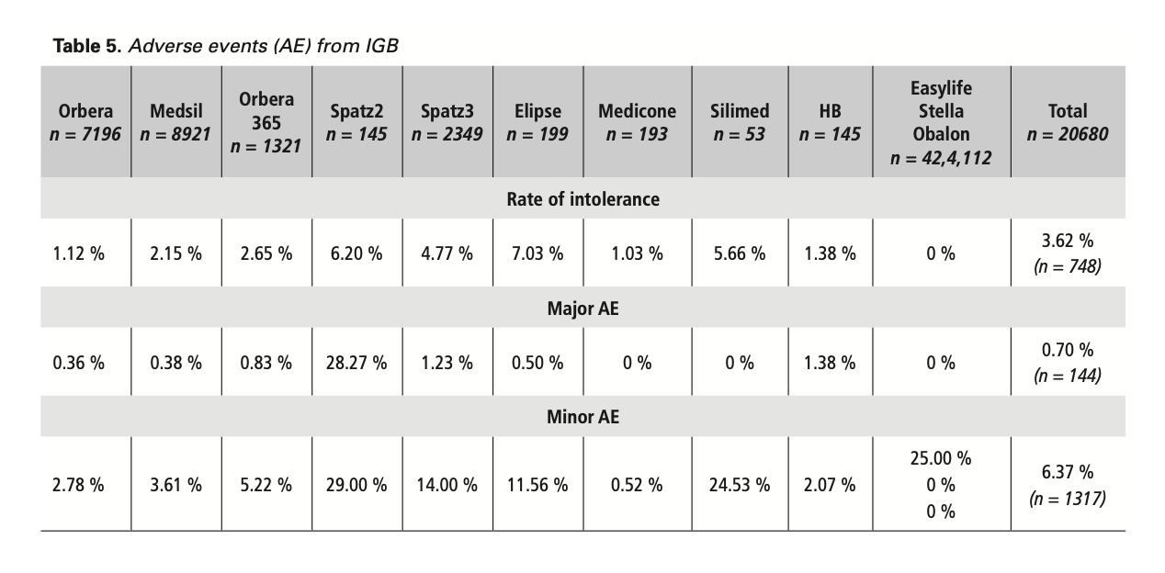
Adverse events data
Most common Major AE: gastric ulcer (0.41%);
Most common Minor AE: esophagitis (3.56%).

Slide 9
Endoscopia bariatrica: da procedura “bridge” a piattaforma terapeutica
10 anni di evoluzione • crescita dei volumi • efficacia clinicamente rilevante del palloncino intragastrico (IGB)
CRESCITA E MATURAZIONE DEL SETTORE
IGB: QUANTO PESO SI PERDE?
2014
2016
2021
≈13%
%TBWL a 6 mesi
7.6–14.1%
%TBWL a 6 mesi nei trial/studi comparativi
14.7k
25.4k
5.3k
procedure endoluminali
mondiali IFSO
procedure endoluminali
primarie mondiali
IGB in Europa*
(+10% vs 2018)
• Non chirurgico e reversibile
• Opzione primaria o “bridge”
• Utile nel percorso multimodale
• Il mantenimento richiede follow-up e terapia dell’obesità
+72%
endoluminale globale 2014 → 2016
Il confronto oltre il 2016 va interpretato con cautela: survey/registri e copertura geografica sono cambiati.
TAKE-HOME | L’endoscopia bariatrica è passata da nicchia a componente strutturale del trattamento dell’obesità; l’IGB offre tipicamente ~10–13% TBWL nel primo anno.
Fonti: Angrisani et al., Obes Surg 2017; Angrisani et al., Obes Surg 2018; Angrisani et al., Obes Surg 2024; Singh et al., Obes Surg 2020; Abu Dayyeh et al., meta-analysis Orbera.

Slide 10
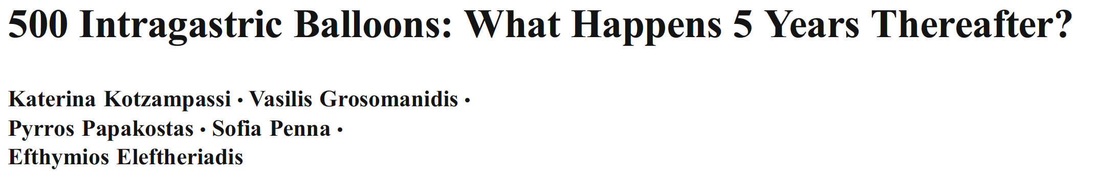
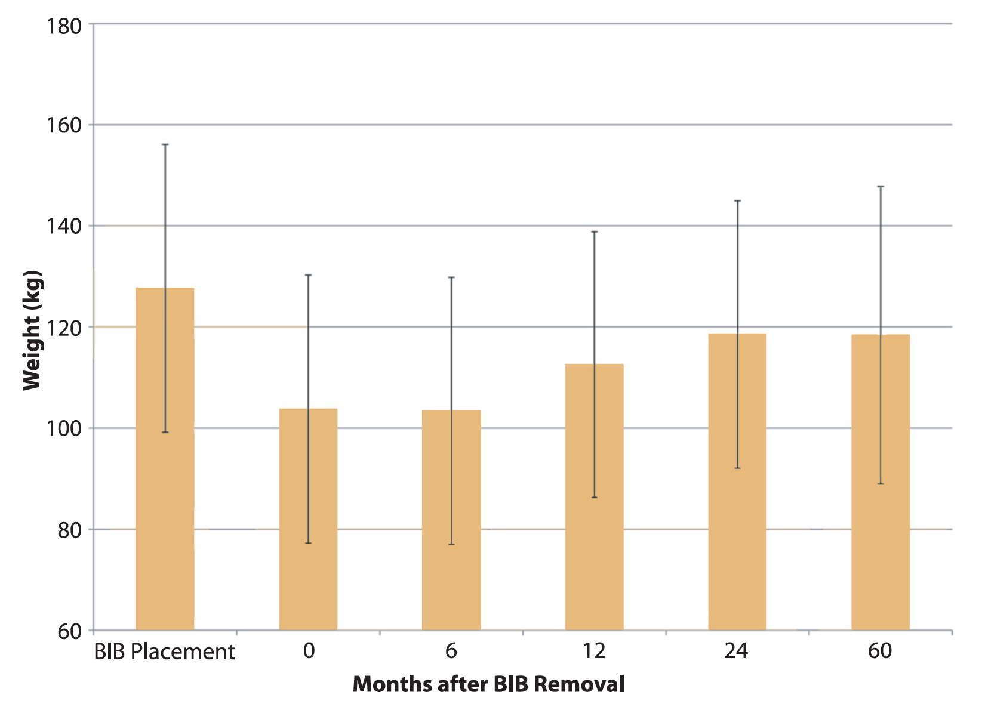
Obes Surg 2012
474
pts
395 pts
387 pts
352 pts
352 pts
195 pts
127.6 kg
118.4 kg
118.3kg
112.5kg
103.7 kg
103.4 kg

Slide 11
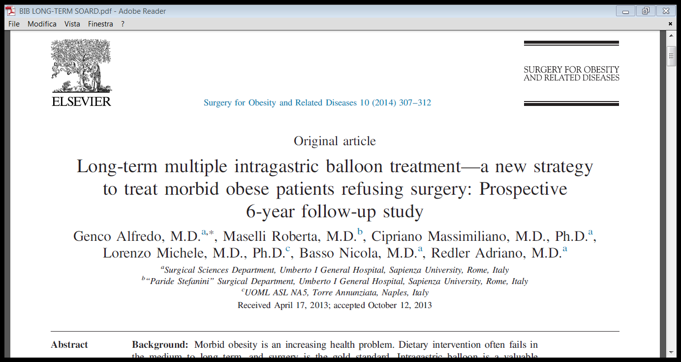

Slide 12
Repeated intragastric balloon: can it provide long-term obesity control?
Genco et al. • Prospective 6-year follow-up • Surgery for Obesity and Related Diseases, 2014
BACKGROUND
METHODS
RESULTS
• Morbid obesity: diet alone often fails to maintain weight loss long-term.
• Bariatric surgery remains the reference treatment, but some eligible patients refuse surgery.
• IGB is effective short-term; the study tested whether repeated balloon placement could extend benefit over 6 years.
• Prospective cohort: n = 83
• BMI >40 kg/m²; surgical candidates who refused surgery
• Baseline: mean age 37.4 y; mean BMI 43.74 kg/m²
• Repeat IGB when ≥50% of weight lost with the previous balloon was regained
• Outcomes: weight/BMI, comorbidities, quality of life
• Follow-up: 72 months (reported endpoint ≈76 months)
43.74 → 37.6
kg/m²
mean BMI
P < .001
80% → 30%
patients with
comorbidities
P = .02
QoL ↑
significant
improvement
P < .001
2nd IGB: 100% • 3rd: 22.2% • 4th: 1 patient
TAKE-HOME | Repeated IGB did not eliminate weight cycling, but maintained a lower BMI and was associated with fewer comorbidities and better quality of life in patients refusing surgery.
Genco A, Maselli R, Cipriano M, et al. Surg Obes Relat Dis. 2014;10(2):307–311. doi:10.1016/j.soard.2013.10.013

Slide 13
Results
follow-up of 76 months
83/83 pt. (100%)
experienced a second balloon placement
18/83 pt. (22.2%)
Placed a third device
1 patient (1.2 %)
Placed the fourth device
18/83 pt. (22.2%)
After a mean interval of 47.7 months (range 12-72), requested bariatric surgery

Slide 14
Obesity Surgery, 16, 1135-1137
Is Bariatric Surgery Necessary after Intragastric Balloon Treatment?
Luigi Angrisani; Michele Lorenzo; Vincenzo Borelli; Monica Giuffrè; Carmine Fonderico; Giuseppe Capece.
A retrospective analysis of the weight loss in patients that after BIB removal underwent bariatric surgery and those who did not wish surgery

Slide 15
Is Bariatric Surgery Necessary after Intragastric Balloon Treatment?
Results
54,4
51,7
48,1
47,6
35,1
Obesity Surgery, 16, 1135-1137

Slide 16
The treatment with IGBalloon could be
the first part of a more complex program
managed by a multidisciplinary team!!!

Slide 17
IGB + pharmacological therapy: why combine them?
From a temporary device to a longitudinal obesity-care strategy
IGB provides an immediate mechanical effect: reduced gastric capacity, delayed emptying and early satiety.
GLP-1 receptor agonists act centrally and peripherally on appetite, satiety and gastric emptying.
The clinical rationale is complementary: maximize initial weight loss and, above all, reduce post-removal weight recurrence.
Key 2026 question: concurrent treatment, or sequential pharmacotherapy after balloon removal?
Rationale synthesized from current IGB and GLP-1RA literature; see studies in following slides.

Slide 18
Semaglutide as adjunct to IGB: 12-month prospective data
Barakat KE et al. — Obesity Surgery, 2025
BACKGROUND | The major weakness of IGB is weight recurrence after device removal.
METHODS | Prospective randomized comparative study; 40 completers (20/group). Semaglutide started in month 2 and continued after IGB removal at month 6.
33.03 kg
12-mo weight loss
IGB + semaglutide
15.56 kg
12-mo weight loss
IGB alone
p < 0.001
between-group difference
at 12 months
After balloon removal: IGB-alone patients regained weight, while the combination group continued to lose weight.
Interpretation: pharmacotherapy may be especially valuable as a maintenance strategy across the post-IGB transition.
Barakat KE et al. Obes Surg. 2025; DOI: 10.1007/s11695-025-08368-5. PMID: 41212463.

Slide 19
Sequential strategy: IGB → semaglutide after removal
Comparative cohort, 2026
BACKGROUND | Concurrent IGB + GLP-1RA may amplify gastrointestinal intolerance; timing may matter.
METHODS | Retrospective cohort, 107 patients: IGB n=37; semaglutide n=48; sequential IGB→semaglutide n=22. Balloon removed at 6 months; semaglutide then given for 3 months.
23.4%
TWL at 12 mo
sequential strategy
13.2%
TWL at 12 mo
IGB alone
8.5%
TWL at 12 mo
semaglutide alone
RESULT | Sequential therapy achieved greater 12-month TWL (p<0.001); monotherapy groups showed regain between months 6–12.
CAVEAT | Retrospective, small sequential group; requires prospective confirmation.
Sequential Intragastric Balloon Followed By GLP-1 Receptor Agonist Therapy in Obesity. 2026. PMID: 42026424.

Slide 20
2026 meta-analysis: promising concept, but no proven superiority yet
Vásquez-Tirado GA et al. — Obesity Medicine, 2026
METHODS | 7 studies, 581 patients: 255 IGB + GLP-1RA vs 326 IGB alone; liraglutide in 4 studies, semaglutide in 3.
PRIMARY OUTCOME | No statistically significant incremental benefit at 12 months for %TWL or %EWL in pooled analysis.
SAFETY | No significant difference in nausea/vomiting (OR 1.36; 95% CI 0.84–2.19).
MAJOR LIMITATION | Very high heterogeneity (I² ≈98% for 12-month weight outcomes), inconsistent protocols and timing.
No eligible tirzepatide studies were identified.
2026 take-home: use combination strategies selectively; the strongest unanswered question is WHEN to add pharmaco-therapy.
Vásquez-Tirado GA et al. Obes Med. 2026;61:100697. DOI: 10.1016/j.obmed.2026.100697.

Slide 21
Are Balloons Dead?
No, they just end!
The role is changing..
Notes:
Balloons are not dead, but their role is evolving.

Slide 22
The Real Role in 2026
Bridge to surgery
Bridge to ESG
High-risk patients
Short-term effective
Not durable
Notes:
In my opinion, balloons should be reframed as a bridge therapy. They are useful in high-risk patients to optimize conditions before definitive treatment. But they should not be considered a standalone long-term solution.

Slide 23
Grazie

